Slide 1

Notes:
Beaver

Slide 2
Staged Delivery
Stage 0
Framework
Stage 1
Unit
Stage 2
Sensors
Power Source
DataHandler Subsystem
Notes:
Beaver

Slide 3
Staged Delivery
Stage 3
Storage Manager
DataHandler Subsystem
Stage 4
Calibration
Processing of Data
Algorithm
Storing Processed Data
Notes:
Beaver

Slide 4
Staged Delivery
Stage 5
Lights
DataHandler subsystem
Stage 6
Gui
Display Raw Data
Stage 7
Networking
Notes:
Beaver

Slide 5
Staged Delivery
Stage 8
GUI
Shows Raw Data
Shows Processed Data
Changes UIC
Calibrate option
Requests Stored Data
Stage 9
Gui Graph Data
GPS data
Gui GPS
Removable Storage
Notes:
Beaver

Slide 6
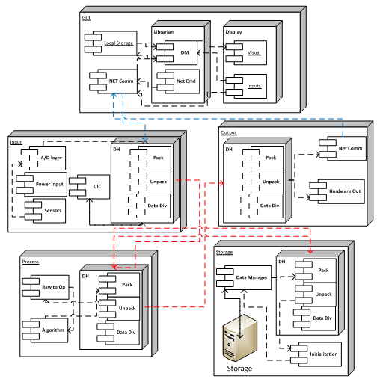
ADS Layers
Notes:
Dawg

Slide 7
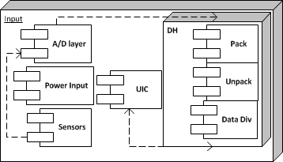
ADS Subsystems
Notes:
Dawg

Slide 8
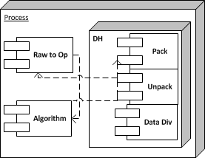
ADS Subsystems
Notes:
Dawg

Slide 9
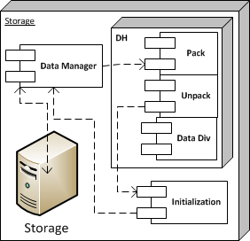
ADS Subsystems
Notes:
Penny

Slide 10
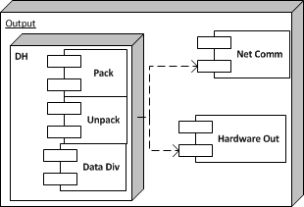
ADS Subsystems
Notes:
Penny

Slide 11
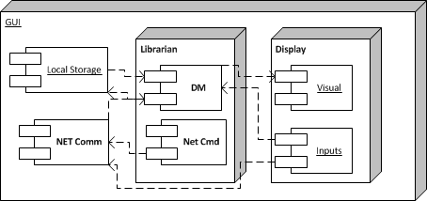
ADS Subsystems
Notes:
Penny

Slide 12
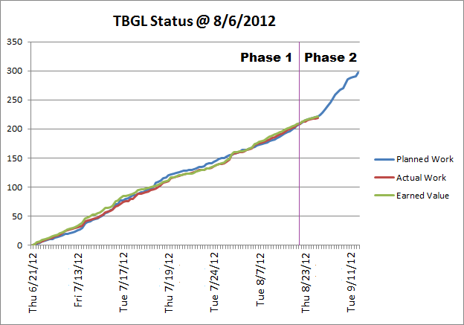
Work Progress
Notes:
Bandit

Slide 13
Work Outlook
ADS Document – Sept. 12
ADS Gate Review – Sept. 13
Team ITUS peer review – before Sept.14
Team Meetings
Meetings w/ Sponsor
Notes:
Bandit

